Slide 1

NETFLIX CONTENT PERFORMANCE AND GROWTH ANALYTICS

Slide 2
INTRODUCTION
Netflix continuously adds new content to attract and retain viewers worldwide. This project analyzes Netflix content performance and growth by examining content type, genre, ratings, and year-wise additions. The insights help understand how Netflix builds and manages its content library over time.

Slide 3
Dataset
Show ID
Title
Type
Genre
Country
Release Year
Rating
Duration Minutes
Viewership Millions
User Rating
Content Type

Slide 4
Business Queries
Do viewers watch TV shows more than movies on Netflix?
How has Netflix viewership changed over time?
Which genres perform well in different countries?
Do Netflix Originals perform better than Licensed content?
How do content ratings affect performance?
Which countries contribute most to Netflix performance?
How has Netflix’s content library grown over time?

Slide 5
Key Metrics
Total Viewership
Represents the overall number of views
Start date
Indicates the earliest release date of content
End date
Indicates the most recent release date of content
Ratings
Average rating of users
Total Titles
Total number of movies and TV shows

Slide 6
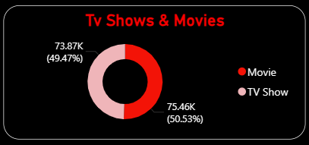
Which Netflix movies and TV shows perform the best?
Why this chart?
Identify viewer preference between Movies and TV Shows
Support content investment decisions
Understand content consumption patterns
Chart Explanation:
This is a donut chart showing the distribution of Movies and TV Shows
Each segment represents the total viewership count
Movies contribute 75.46K (50.53%)
TV Shows contribute 73.87K (49.47%)
Conclusion:
Netflix does not rely on a single content type. Both Movies and TV Shows perform almost equally well, showing a balanced content strategy.

Slide 7
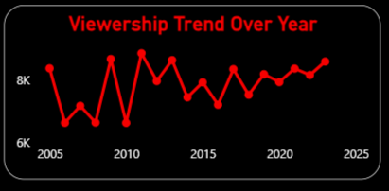
How has Netflix viewership changed over time?
Why this Chart?
Line chart is used to analyze how Netflix viewership has changed over time. It helps understand growth trends, fluctuations, and long-term viewer engagement instead of focusing on sales or revenue.
Explanation:
This is a line chart showing viewership trend over years
X-axis represents the years
Y-axis represents the viewership count
The red line indicates changes in viewer engagement year by year
Conclusion:
Netflix viewership has grown steadily over time despite minor fluctuations. The overall upward trend indicates strong audience retention and increasing platform popularity. This suggests that Netflix’s content strategy and expansion efforts are effective in maintaining long-term viewer interest.

Slide 8
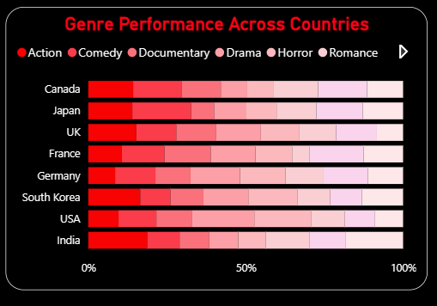
Which genres perform well in different countries?
Why this Chart?
The primary reason for using a stacked bar chart is to show part-to-whole relationships. It allows for a direct comparison of the total performance across different countries while simultaneously showing how much each individual genre contributes to that total. It is an excellent choice when you want to highlight the relative proportion of different categories (genres) within each group (country).
Explanation:
X-Axis (Percentage): Represents the cumulative performance from 0% to 100%.
Y-Axis (Countries): Lists various global markets (Canada, Japan, UK, France, Germany, South Korea, USA, India).
Color-Coded Segments: Each color in a single bar represents a different genre (e.g., Action, Comedy, Drama).
Segment Width: The wider a colored segment, the higher the performance of that specific genre in that country. For instance, the large red segments for South Korea indicate a dominant preference for Drama.
Conclusion:
The data reveals that content preferences are highly regional. While some genres like Comedy and Drama perform well globally, others have specific strongholds; for example, Action has a significantly larger footprint in India and Germany compared to Canada or the UK.

Slide 9
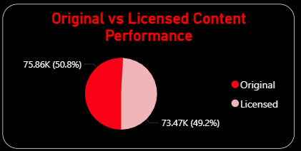
Do Netflix Originals perform better than Licensed content?
Why this chart?
It's a Pie Chart, perfect for showing a direct part-to-whole comparison between just two categories.
Explanation:
Originals (Red): 50.8% (75.86K)
Licensed (Pink): 49.2% (73.47K) The split is nearly even, with a marginal lead for original content.
Conclusion:
Originals hold a slight edge, but both content types are equally vital to Netflix’s performance.

Slide 10
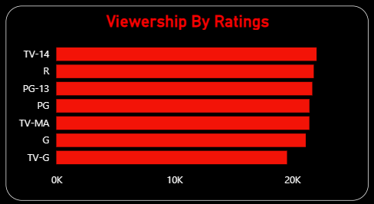
How do content ratings affect performance?
Why this chart?
It’s a Horizontal Bar Chart, which is ideal for ranking categories.
Explanation:
The chart ranks viewership from TV-14 (highest) down to TV-G (lowest).
Lowest Performers: G (General audience) and TV-G (Kids and Families) show significantly lower viewership compared to mature-rated content.
Conclusion:
Content geared toward mature audiences and teenagers (TV-14, R, PG-13) is the primary driver of performance.
G refers General audience
TV-G refers Kids and Families
PG refers Parental Guidance
PG-13 refers Teens(13+)
TV-14 refers Teens & Adults
R refers Restricted (Adults)
TV-MA refers Mature Adults only

Slide 11
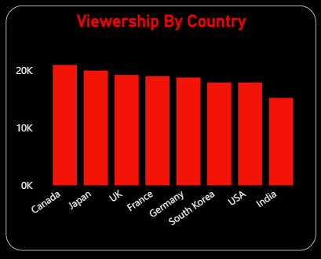
Which countries contribute most to Netflix performance?
Why this Chart?
It’s a Vertical Bar Chart (Column Chart), which is the standard for comparing discrete categories. It uses the height of the bars to make the performance differences between countries immediately clear.
Explanation:
X-Axis: Lists specific countries (Canada, Japan, UK, France, Germany, South Korea, USA, India).
Y-Axis: Measures viewership, ranging from 0K to over 20K.
Ranking: Canada leads with the highest viewership (above 20K), followed closely by Japan. India shows the lowest viewership among the countries listed.
Conclusion:
While Netflix has a strong global presence, Canada and Japan are currently its most significant contributors to performance. There is a noticeable downward trend in viewership as you move toward the USA and India, suggesting room for growth in those markets.

Slide 12
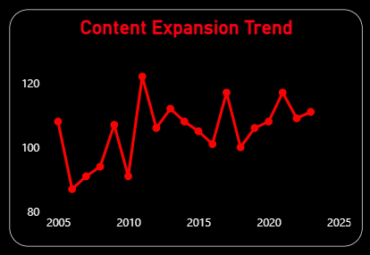
How has Netflix’s content library grown over time?
Why this chart?
Line chart is a visual representation of the growth and fluctuations in Netflix's content library over a 20-year period
Explanation:
It displays data points from 2005 to 2025, showing significant variations in content volume. There are notable peaks around 2005 and 2015, followed by subsequent dips.
Conclusion:
The overall long-term trend appears to indicate a growing library, with a projected increase in content towards 2025

Slide 13
CONCLUSION
This project used Power BI to analyze Netflix content performance and growth, converting data into clear business insights. The analysis supports data-driven decisions to improve content strategy, and regional performance.

